Slide 1

1
Presentation
CampHire
Presented by :
Harshit Shekhar (2300290140073)
Harsh Chaudhary (2300290140067)
Piyush Pratap Singh (2300290140116)
Under the supervision of
(Dr.) Akash Rajak (Prof.)
KIET Group of Institutions, Delhi-NCR, Ghaziabad
DEPARTMENT OF COMPUTER APPLICA

Slide 2





2
Table of Contents
1. Introduction
5. ER Diagram
6. Data Flow Diagram
7. References/Bibliography

Slide 3


4
Introduction
Student Job Search Challenges: Many students struggle to find relevant job opportunities.
CampHire's Solution: A platform connecting students and employers for a streamlined hiring process.
Student Features: Profile creation, job applications, real-time skill assessments.
Employer Features: Job postings, applicant review, data-driven hiring tools.
SDG Alignment: Supports Quality Education (SDG 4) and Decent Work & Economic Growth (SDG 8).
Skill-Based Focus: Real-time tests and Skill Match system emphasize merit.
Technology Stack: Built using the secure and scalable MERN stack.
Platform Features: Email notifications, role-based authentication, verified student logins.
Key Benefits: Efficient job applications, improved employer-student interaction, workforce preparation for students.

Slide 4

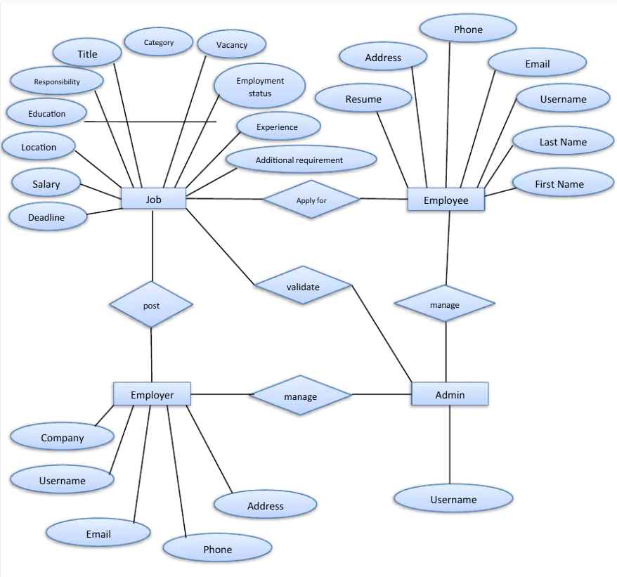
7
ER Diagram

Slide 5
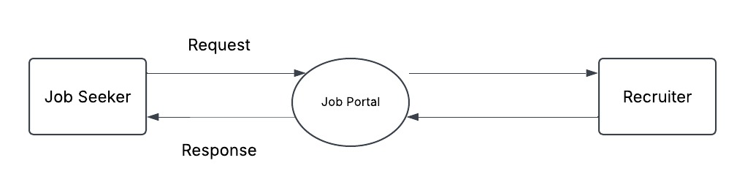
8
Data Flow Diagram

Slide 6
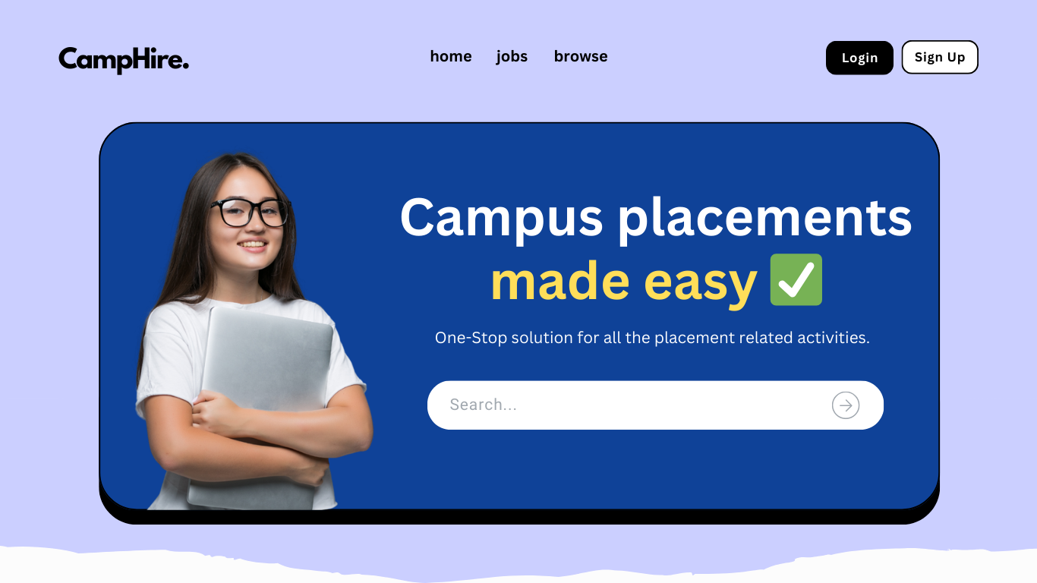
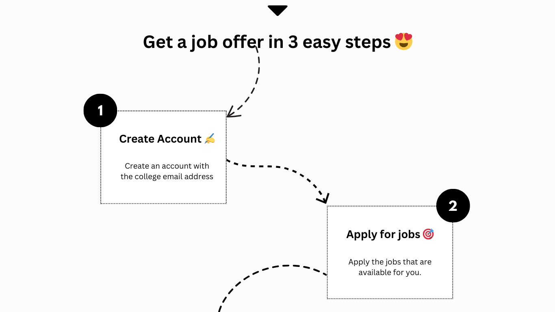
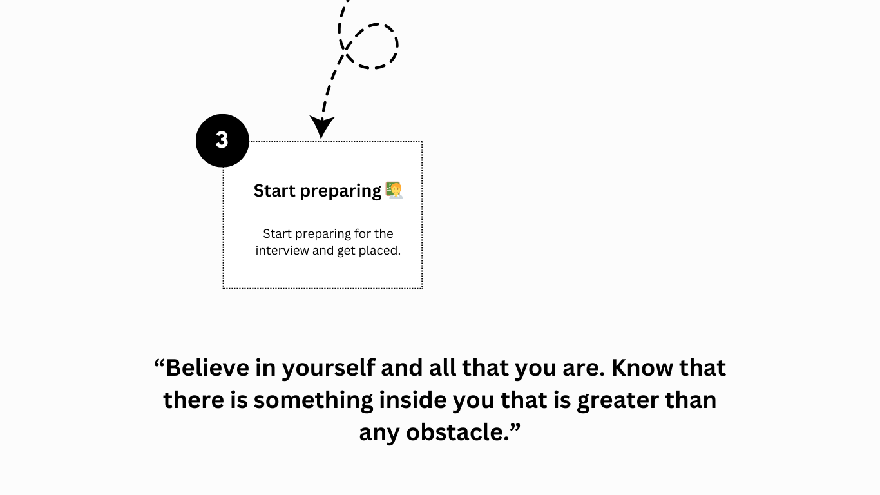
9
Prototypes
Home Page

Slide 7
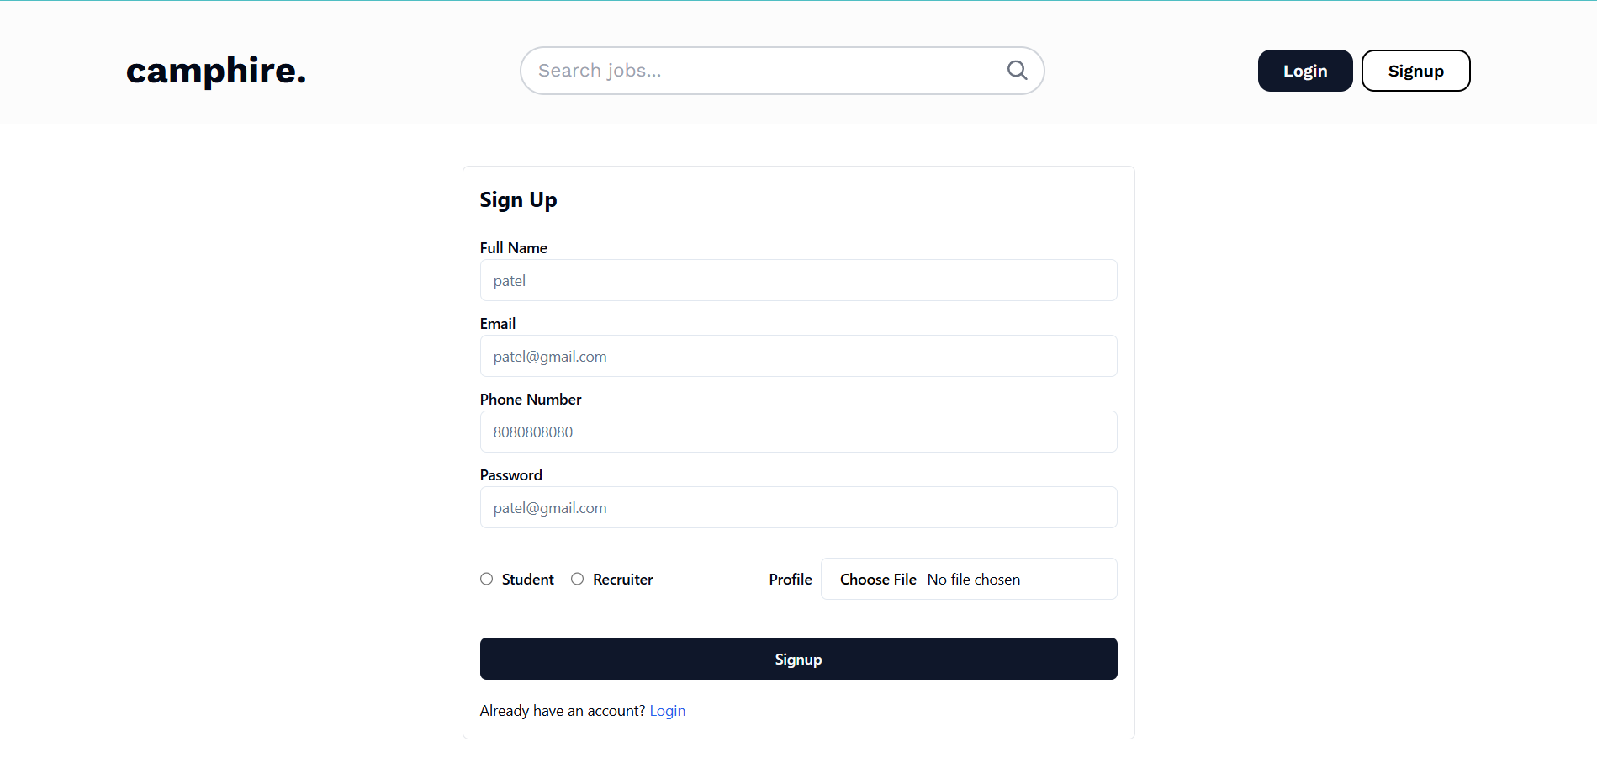
9
Prototypes
Signup Page

Slide 8
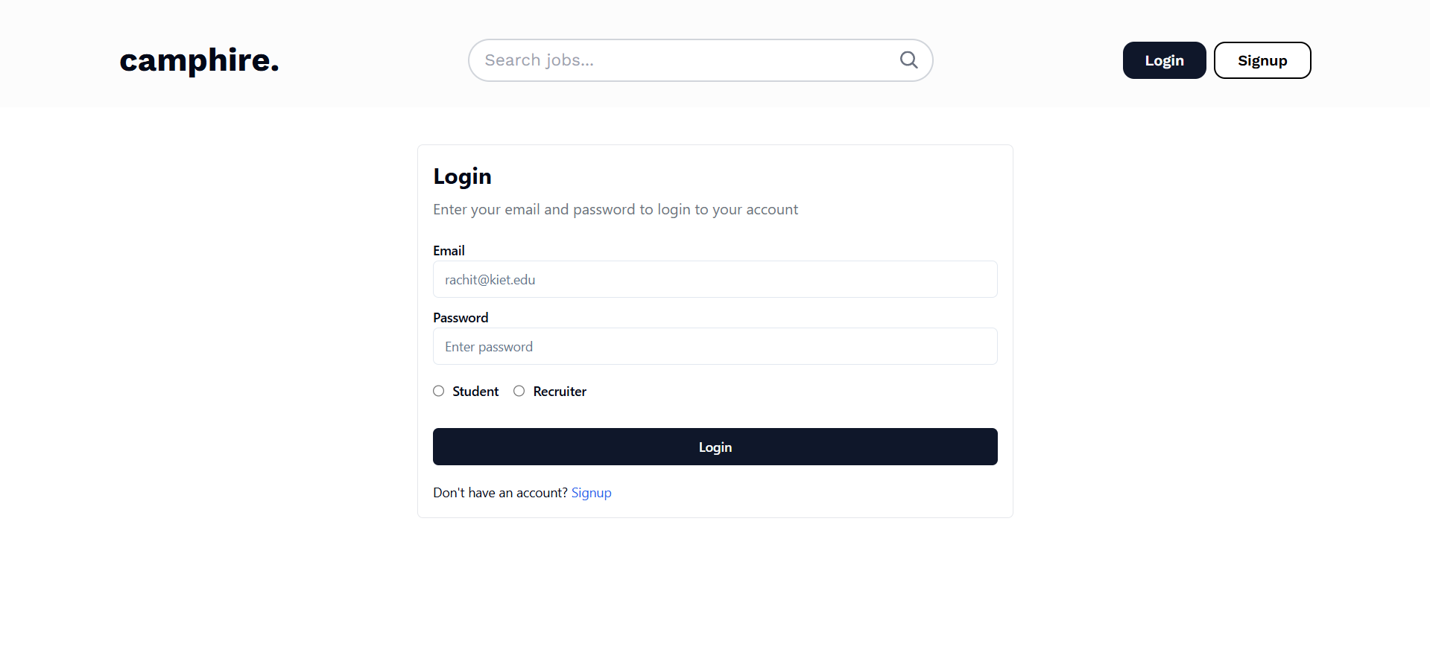
9
Prototypes
Login Page

Slide 9
9
Modules
User Module
The user module contains the Student and Recruiter details. The details that this module contains are:
Full name
Email
Phone
Password
Type (Student or Recruiter)
Profile Image
Resume Link (For Student)
Company

Slide 10
9
Modules
Application Module
The user module contains the application details. The details that this module contains are:
Job
Applicant
Status (Pending, Accepted, Rejected)

Slide 11
9
Modules
Job Module
The user module contains the job details. The details that this module contains are:
Job
Applicant
Status (Pending, Accepted, Rejected)

Slide 12
9
Bibliography
Website Development Resources
· Duckett, Jon. HTML and CSS: Design and Build Websites. Wiley, 2011.
· Duckett, Jon. JavaScript and JQuery: Interactive Front-End Web Development. Wiley, 2014.
Database and Backend Development
· Welling, Luke, and Laura Thomson. PHP and MySQL Web Development. Addison- Wesley, 2008.
· Murach, Joel. Murach's MySQL. Mike Murach & Associates, 2012.
UI/UX Design
· Tidwell, Jenifer. Designing Interfaces: Patterns for Effective Interaction Design. O'Reilly Media, 2019.
· Krug, Steve. Don't Make Me Think: A Common Sense Approach to Web Usability. New Riders, 2014.
Project Management and Development
· Sommerville, Ian. Software Engineering. Addison-Wesley, 2015.
· Pressman, Roger S. Software Engineering: A Practitioner's Approach. McGraw-Hill Education, 2014.

Slide 13

THANK YOU

